Slide 1
Library Management System
Team - 9
19Z331 – Ajith Narayana
19Z333 -Dhanush reddy
19Z359 -vasanthan M
20z464- Rithish.B

Slide 2
Library Management System:
Library Management System is an application which refers to library systems.It is used by librarian to manage the library record various transactions like issue of books, return of books, addition of new books, addition of new students etc. Books and student maintenance modules are also included in this system which would keep track of the students using the library and also a detailed description about the books a library contains.The librarian is able to generate different kinds of reports like lists of students registered, list of books, issue and return reports. All these modules are able to help librarian to manage the library.Student can create his profile and student can edit his profile,change password,student can also view issued books.

Slide 3
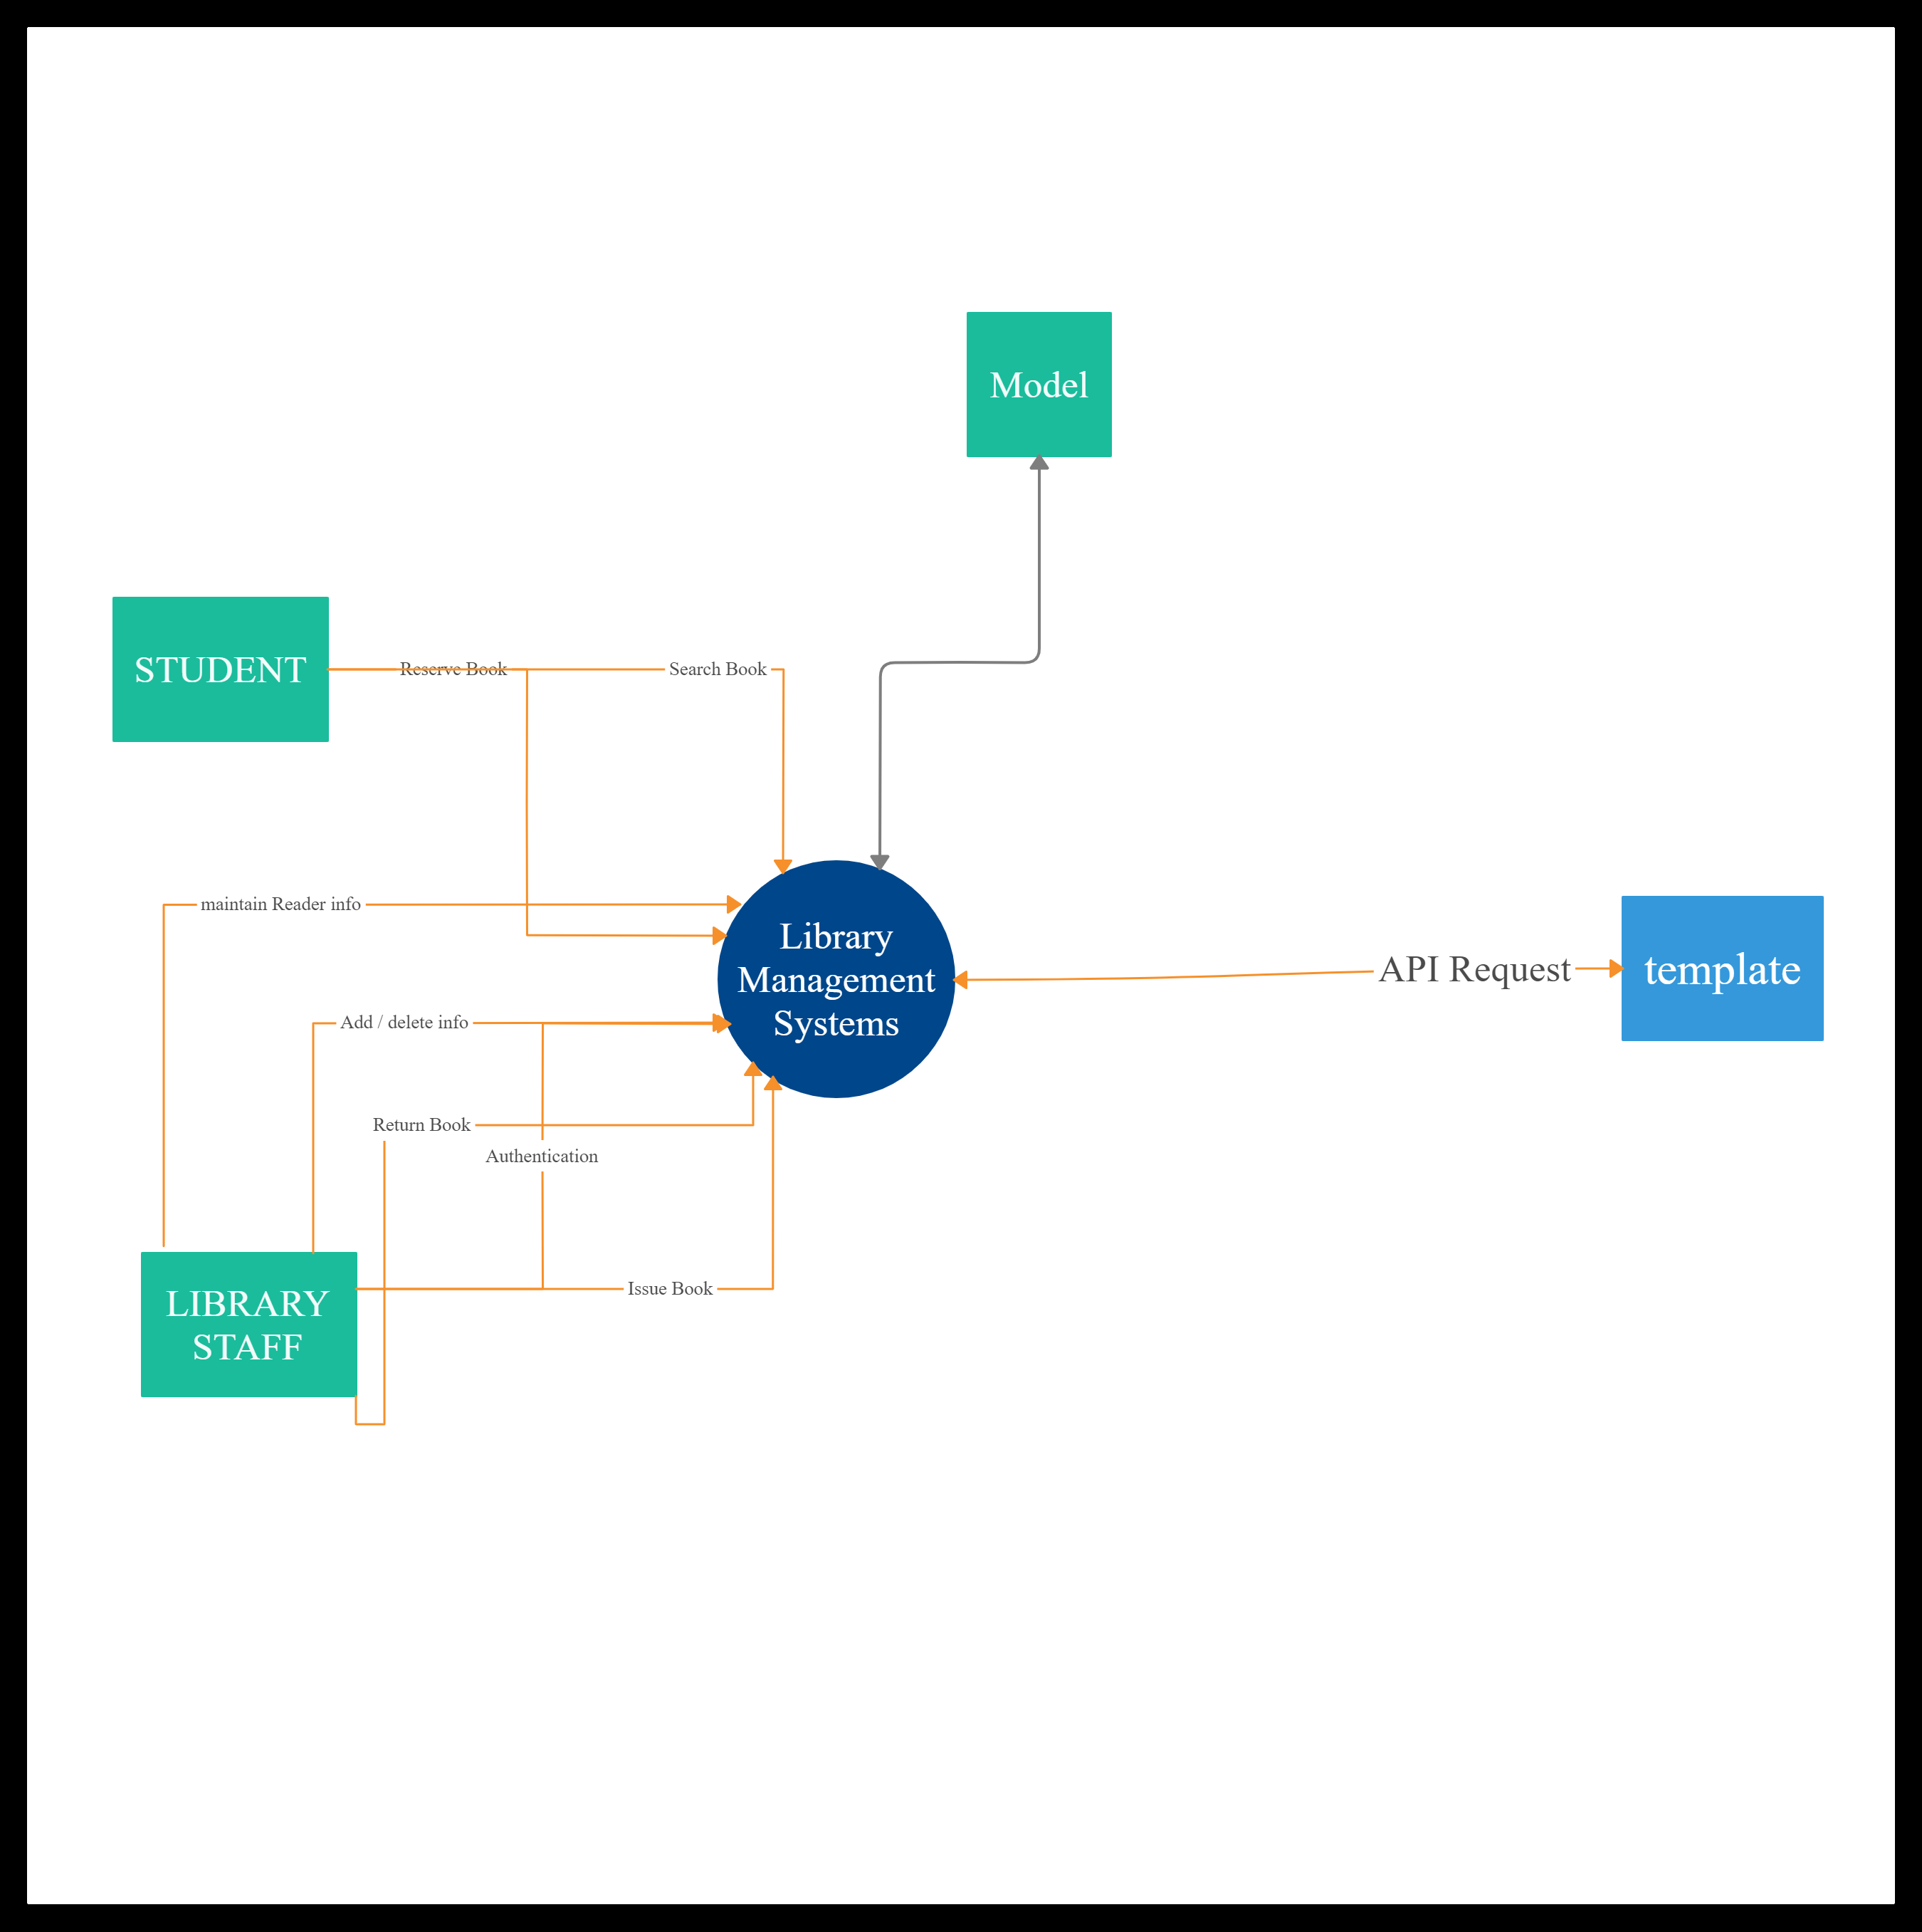
System Architecture,block diagram:- our project works on MVT design pattern

Slide 4
Tools used, front and back end:
Front end:
HTML, CSS , javascript
Back end:
djanjo Framework,sqlite3

Slide 5
FEATURES IMPLEMENTED
Admin can issue books,view students,view issued books to students,admin can add books to the library,admin can also view available Book,search bar at admin,admin can also delete students,books Under student he/she can view books issued to them,we have created a student profile,student can change password,student can also edit his profile. We have to implement return book feature in admin portal Admin can also download the information of books,students

Slide 6
Contributions and Challenges Faced:-
Ajith | Worked on Staff Module[backend] | Understanding Djanjo Frame work
Dhanush | Worked on student,staff module [backend] | Connections between backend and front end
vasanthan | Worked on staff module[frontend] | Learing javascipt,Css styling
ritish | Worked on student[frontend] | Learing javascript,Css styling

Slide 7
REFERENCES
https://docs.djangoproject.com/en/3.2
https://developer.mozilla.org/en-US/docs/Web/HTML
https://developer.mozilla.org/en-US/docs/Web/CSS
https://developer.mozilla.org/en-US/docs/Web/JavaScript

